Slide 1
IV INTERNATIONAL YOUTH SCIENTIFIC CONGRESS
NANOSCIENCE AND NANOTECHNOLOGY
Nanotechnology for Urban Revolution: Smart Cities

Slide 2
Research Group
Abdalla, Adam Spragge – Denmark
Dabrowska, Aleksandra – Poland
Dresler, Urban – Slovenia
Expósito Martínez, Adrián – Spain
Graning, Sára – Hungary
Li, Alexander – Austria
Mikanovic´, Relja - Serbia
Van Dooren, Martjin – Belgium
Wagner, Diana – Germany
Willekes, Jordy – The Netherlands
Zanoli, Chiara – Italy
Mr. Jorge Barallobre Soto – Chairman
Mrs. Júlia Gimbernat Mayol – Assistant Chairwoman

Slide 3
Index
Nanotechnology
Smart City
The story about Pepe
Current situation
Global scale (water, health and pollution)
Costs and ethical issues
Conclusion

Slide 4
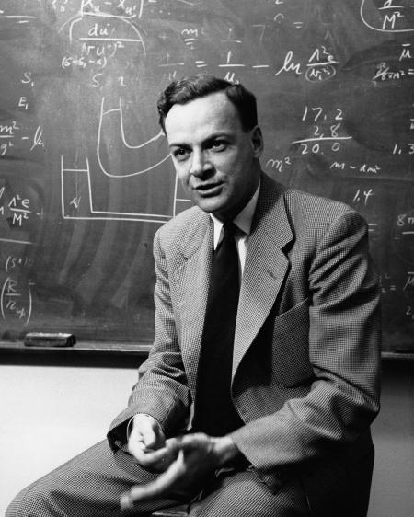
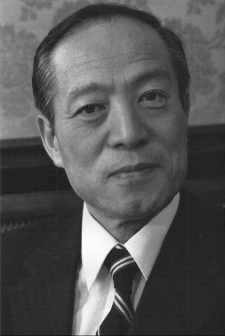
Nanotechnology
History
” Nanoscience and nanotechnology are the study and application of extremely small things [0,1-100nm] and can be used across all the other science fields, such as chemistry, biology, physics, materials science, and engineering.” (NNI)
Richard Feynman
Norio Taniguchi

Slide 5
WHY NANO?

Slide 6
Small
1.

Slide 7
Going through small passages
2.

Slide 8
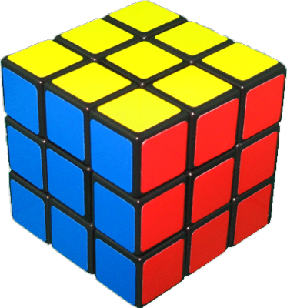
Surface area
3.

Slide 9
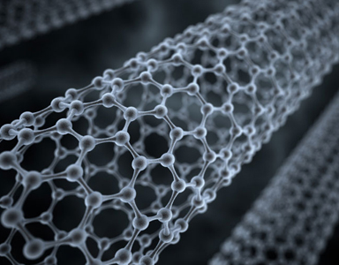
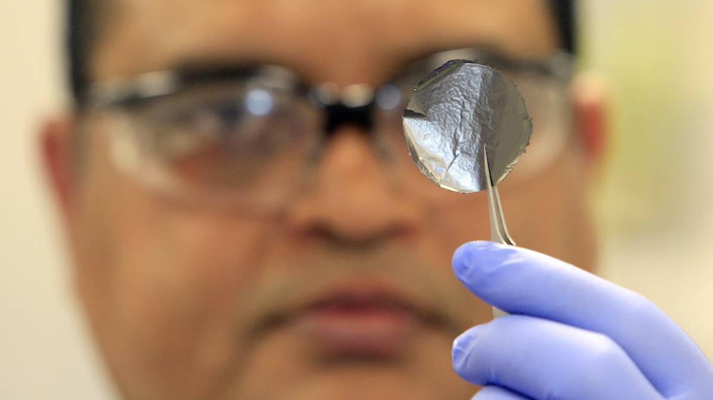
Nano-structures
Nanotubes
Nanoparticles
Graphene

Slide 10
Smart City
Non-universal definition
Smart City examples
Notes:
Deakin, Mark; Al Waer, Husam. "From Intelligent to Smart Cities"

Slide 11
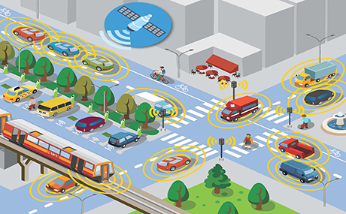
Construction
Transportation
Energy
Internet of Things (IoT)

Slide 12
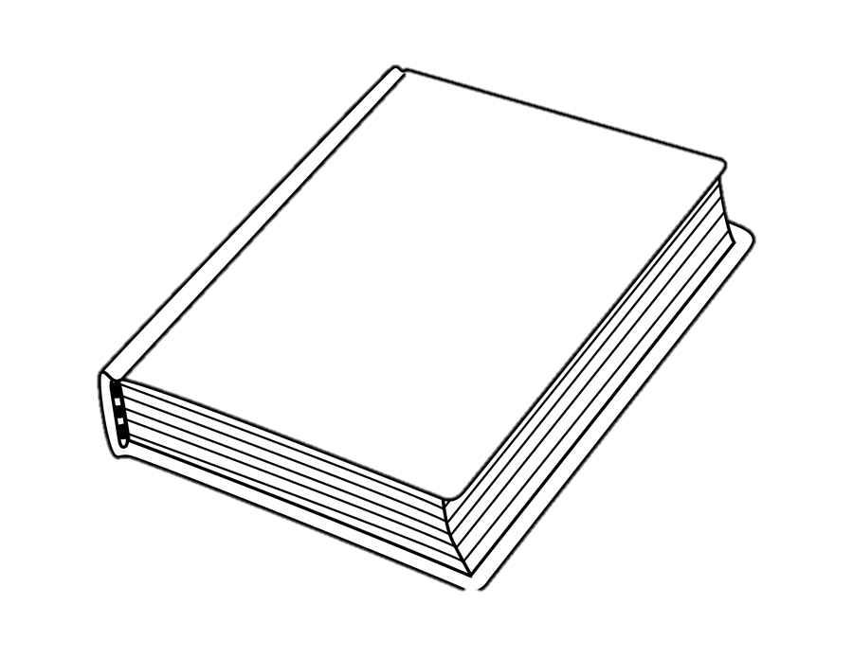
Individual Scale
The story
about Pepe

Slide 20
What about a large group of Pepes?

Slide 21
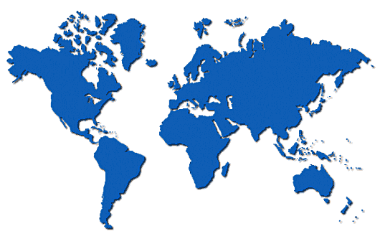
Actual Situation
Brussels
Songdo
Masdar
Málaga

Slide 22
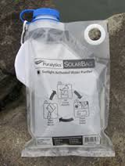
Global Scale: Water and Health

Slide 23
Global Scale: Environmental Pollution

Slide 24
Global Scale: Costs
Investment
Profit
Research
Spread of Nanotechnology
More efficiency
Mass Production
Cheaper

Slide 25
Global Scale: Ethical issues
HACKING
EVERYTHING LINKED
PRIVACY PROBLEMS
SOLUTION
Ethical problems
Raising awareness

Slide 26
CONCLUSIONS
“One day mankind decided to go out of their caves to challenge the impossible and to follow the difficult path, the easy path would have meant conformity”
Martín Hidalgo

