Slide 1
IV INTERNATIONAL YOUTH SCIENTIFIC CONGRESS
SPACE SCIENCE
Manned Mission to Mars

Slide 2
Participants
Chairman: Borja González Moure
Assistant Chairwoman: Belén Alonso López
Leon Neidenbach – Austria
Beáta Nagy – Hungary
Aleksandar Popović - Serbia
Jaime Urbón Menéndez – Spain
Allessia Sacchi – Italia
Janine Kachel – Germany
Eran Arntz – The Netherlands
Jens Jochems – Belgium
Svit Rodež – Slovenia
Natalia Wosik – Poland
Marie Amalie Præstegaard - Denmark

Slide 3
Basic Information
 | Earth (=Blue Planet) | Mars (=Red Planet)
Moons | Moon | Phobos, Deimos
Rotation time | 24 hours | 24 hours 37 minutes
Revolution time | 365,25 days | 687 days
Distance from Sun | 150 million km | 229 million km
Equatorial diameter | 12.756 km | 6.792 km
Volume | 6 Marses | 1/6 of Earth
Average temperature | 15 °C | - 63 °C

Slide 4
Basic Information
 | Earth (=Blue Planet) | Mars (=Red Planet)
Atmosphere | 78% N₂, 21% O₂, 1% Ar, + 0,04 CO₂ | 95% CO₂, 3% N₂, 2% Ar
Atmospheric pressure | 1013 milibars | 6 milibars
Gravity | 1G | 0,4 G
Magnetic field | Yes | No
Water | Available in all forms | Ice caps (+liquid water?)
Geological structure | Core: Iron and Nickel, Crust and Mantle: Silicates, (+Aluminium) | Core: Iron and Nickel, Crust and Mantle: Silicats
Volcanic activity | Yes | (?) Olympus Mons

Slide 5
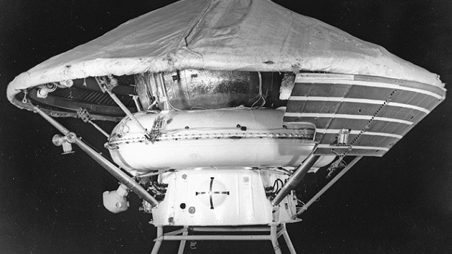
Past missions (-1988)
1960-Mars1962b (Soviet Union): failed
1965-First successful flight-by mission: Mariner 4
1971-first probe to orbit another planet: Mariner 9
1971- Mars 3: first soft landing on Mars
1975- Viking program
1988- Phobos 1 and 2

Slide 6
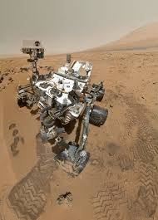
Past missions (1997-2016)
1997-Mars Global Surveyor- complete mapping of Mars
2001-Mars Odyssey
2004- Mars Exploration Program(Spirit and Opportunity)
2008- Phoenix Lander
2012-Curiosity
Indian Space Research Organization

Slide 7
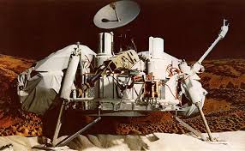
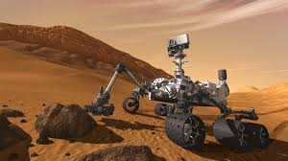
Current Missions
Operational rovers:
Curiosity and Opportunity
Operational orbiters:
Mars Odyssey, Mars Express, Mars Reconnaissance Orbiter, Orbiter Mission, MAVEN.

Slide 8
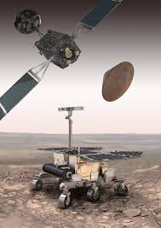
Future missions
2016- InSight rover
Focus on finding life and sending humans
2020- ESA and RFSA team up for ExoMars
2018/2020: ISRO-Mangaalyaan 2
Mars Scientific Lab. plans to launch a rover in 2020
2020- China missions to Mars

Slide 9
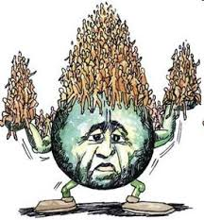
Why Mars?
Exploration
Progress of technology
In search of extraterrestial life
Last resort: Saving the species
Unite people

Slide 10
Challenges to face: a story
GETTING THERE
1. Lift off: Boosters
2. In space
Propulsion system → getting there faster
Radiation
3. Landing: Speed

Slide 11
Challenges to face: a story
ONCE THERE
4. The first month:
- Survival:
Base
Resources
- Psychological issues:
Isolation
Social interaction
- Physical issues:
Microgravity
Injuries
5. Radiation

Slide 12
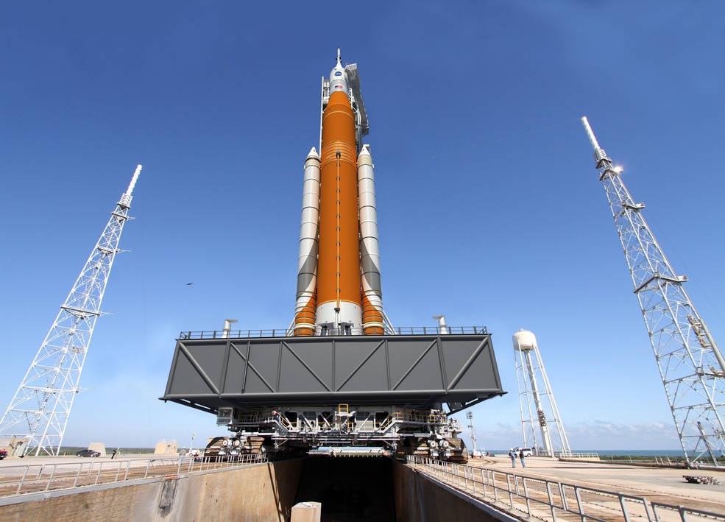
Launching the rocket
TOTAL
≈ 4500 tons of cargo needed
Space Launch System | Falcon Heavy
130 000 kg | 13 600 kg
500 million $ | 90 million $
NASA (public) | SpaceX (private)

Slide 13
Way from Earth to Mars
PROTECTION FROM RADIATIONS | Growing plants on spacecrafts | Hyperproteic food | Recycle waste | Artificial gravity | Places for exercising
ENERGY AND FUEL | “Magnetic field” generator | Proper clothing | Passive isolation
SUPPLIES AND PHYSICAL NEEDS | Solar pannels | Batteries | Common propellants

Slide 14
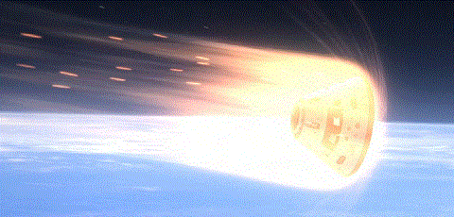
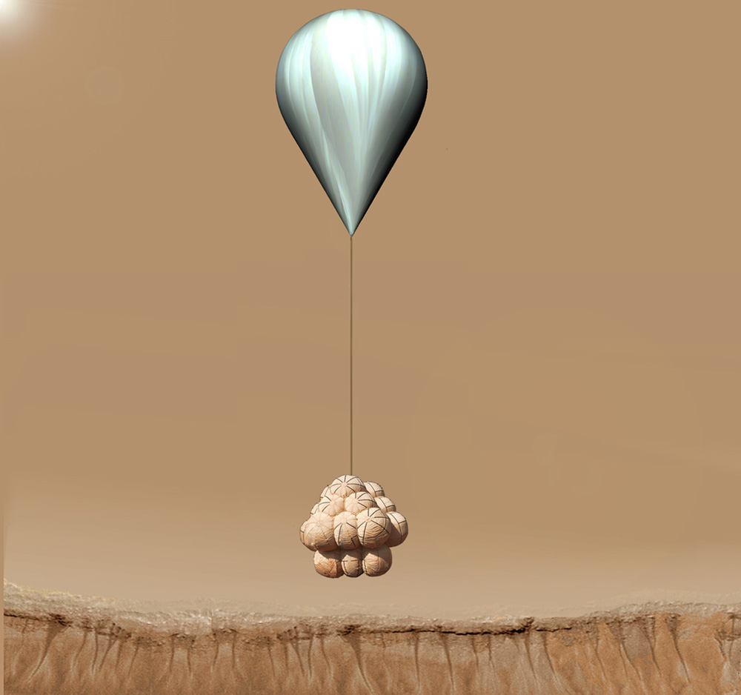
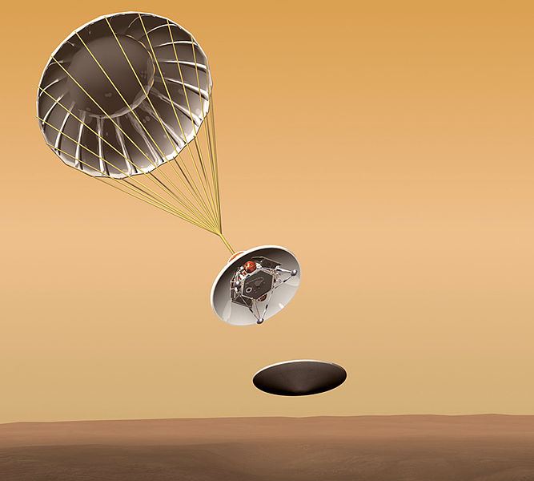
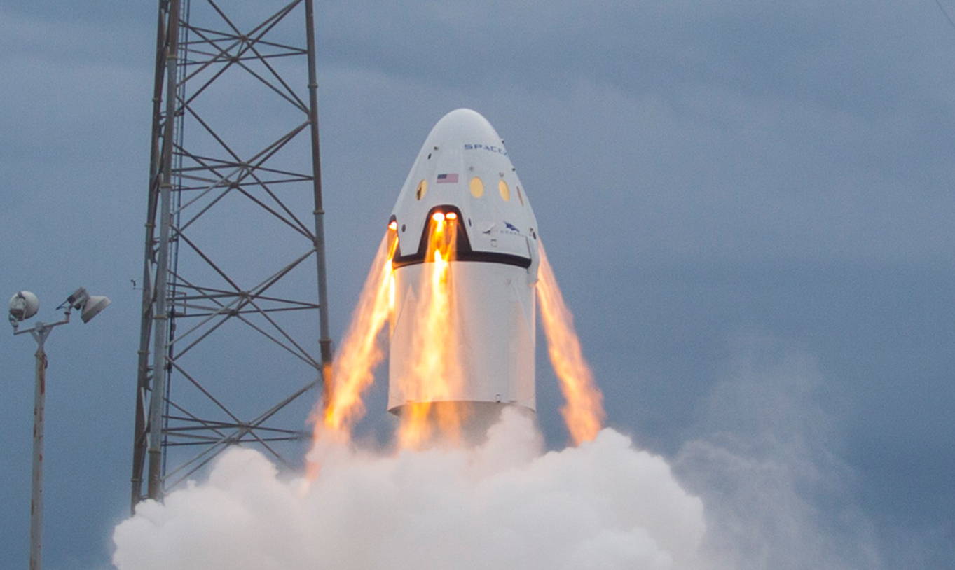
Landing on Mars (thinner Atmosphere)
Heat-shields
Parachutes
Airbags
Thrusters

Slide 15
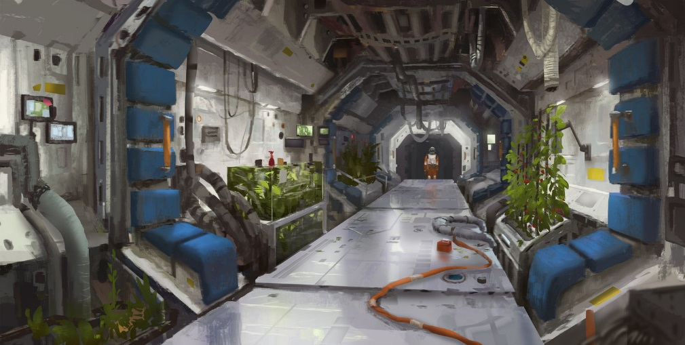
Once there: Techniques
Possible contamination of both, Mars environment and humans
Emergencies
Communication: Mars internet (DSCN) & satellites
Living quarters:
BEAM
Underground constructions
3D printers
MOXIE
Artificial Magnetic field

Slide 16
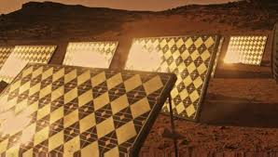
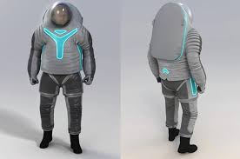
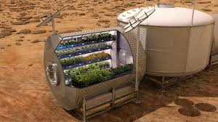
Food and Water:
Growing plants
Insects
Condensation from Martian soil
Energy Supply:
Solar pannels
Nuclear energy
Astronauts health:
Daily rehabilitation
Constant communication
Spacesuits

Slide 17
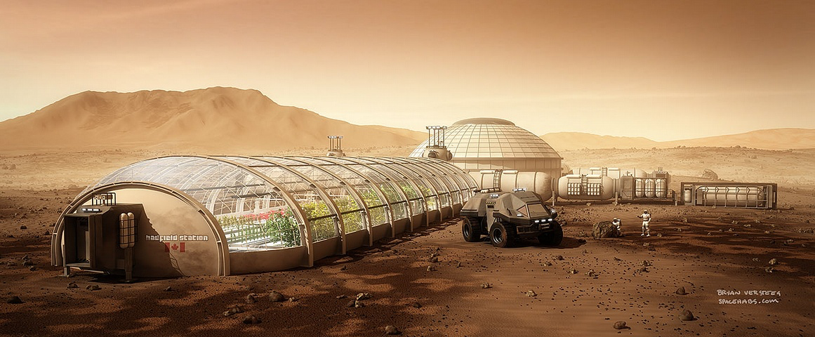
Is it realistic?

Slide 18
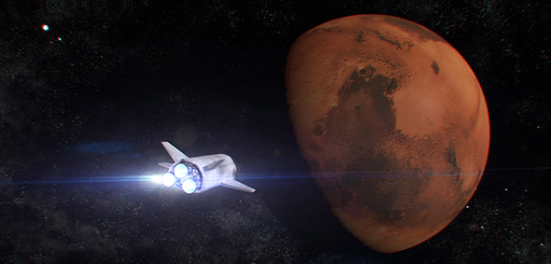
Summary – How to get there?

Slide 19
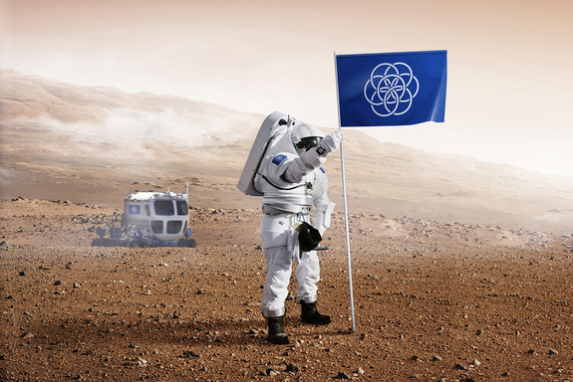
What to do when we arrive?
Making Mars habitable - Terraforming - Living underground
Sovereignty
Social Development

Slide 20
Why?
Human nature Curiosity
Development of Science
Survival of the Species

Slide 21
Making it all possible
Raising Awareness
Funding Science
Industries
International Collaboration

Slide 22
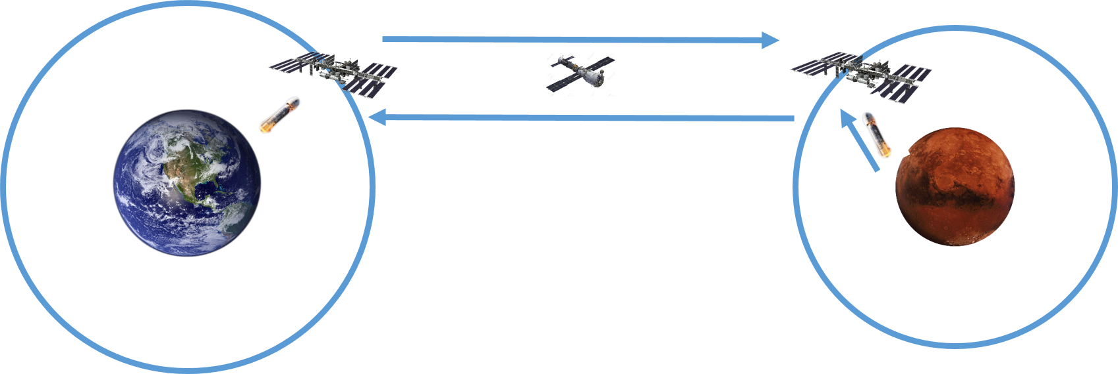
Strategy

Slide 23
