Slide 1
IV INTERNATIONAL YOUTH SCIENTIFIC CONGRESS
ENERGY AND ENVIRONMENTAL SCIENCES
Electric vehicle or hydrogen-powered vehicle

Slide 2
“Energy, enviromental sciences”
Line Chairman:
Mr. Rodrigo Peña Salvador
Participants:
Abrisqueta Manzanaro, Claudia
Dendooven, Laura
Ehlken, Maximillian
Farrokhi, Shayan
Godec, Jaka
Kolakowski, Benjamin
Assistant Chairman:
Mr. Josep Maria Salvia Hornos
Lexova, Karolina
Poppe, Marc
Previdi, Giorgio
Ramesh, Rebecca
Tica, Luka
Wootsch, Benedek

Slide 3
“The truth is you don’t know what is going to happen tomorrow. Life is a crazy ride, and nothing is guaranteed”

Slide 4
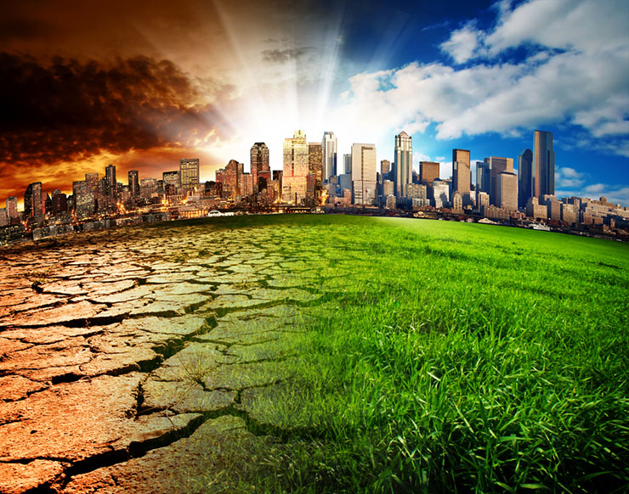
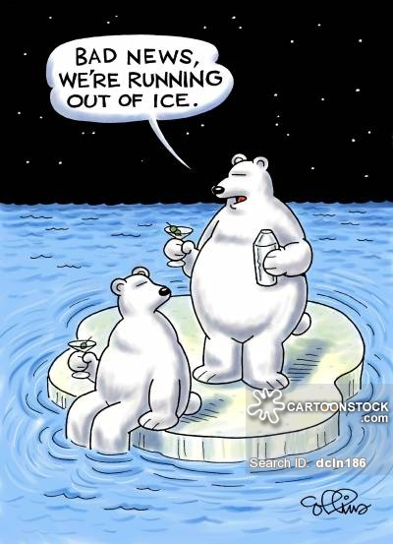
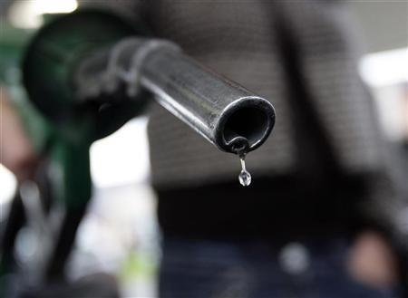
Reasons for changing our life-styles
Climate change
Greenhouse effect
CO₂ emission
Melting of ice caps
Lack of oil
Highly-dependant

Slide 5
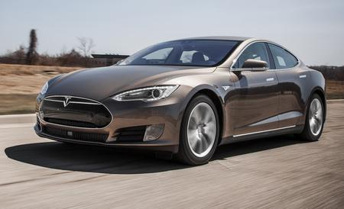
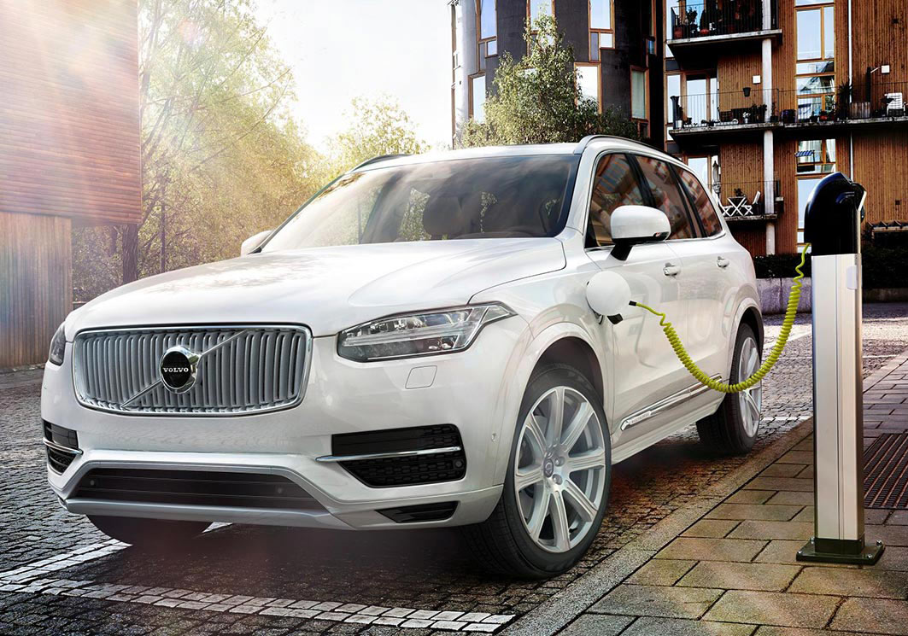
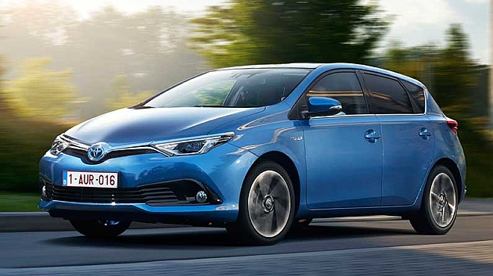
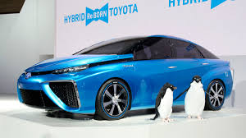
Types of technology
Electric vehicle
Battery electric vehicle
Hybrid
Plug-In Hybrid
Hydrogen-powered vehicle
Fuel cell
Electric vehicle
Plug-In Hybrid
Hybrid
Hydrogen-powered vehicle

Slide 6
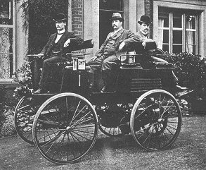
Electric vehicle
1880 first production
Superseded by petrol powered vehicles
Rechargeable battery
First one to break the barrier of 100km/h

Slide 7
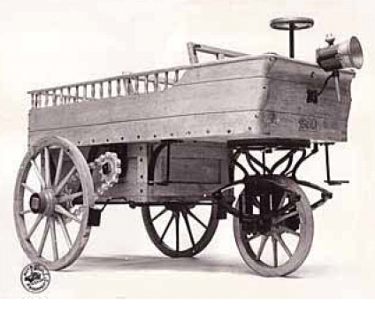
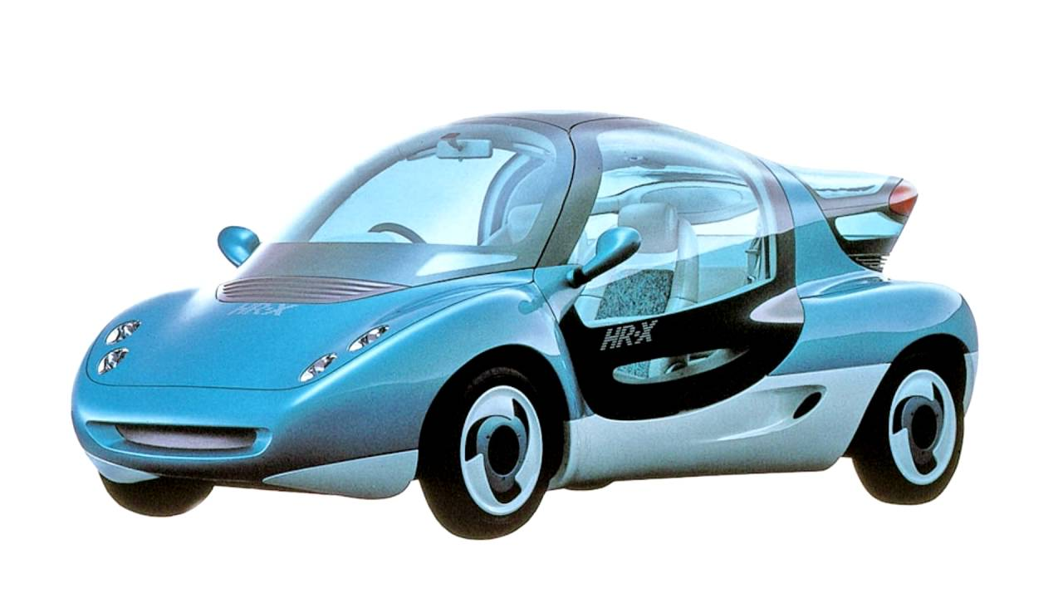
Hydrogen-powered vehicle
1863 Hippomobile
1991 first production
Powered by fuel cells
Hippomobile
Mazda HR-X

Slide 8
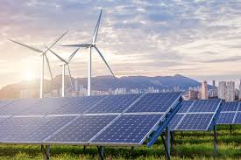
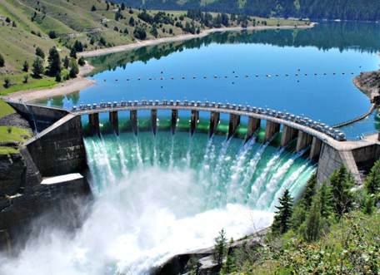
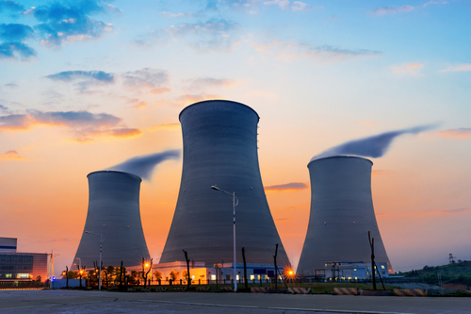
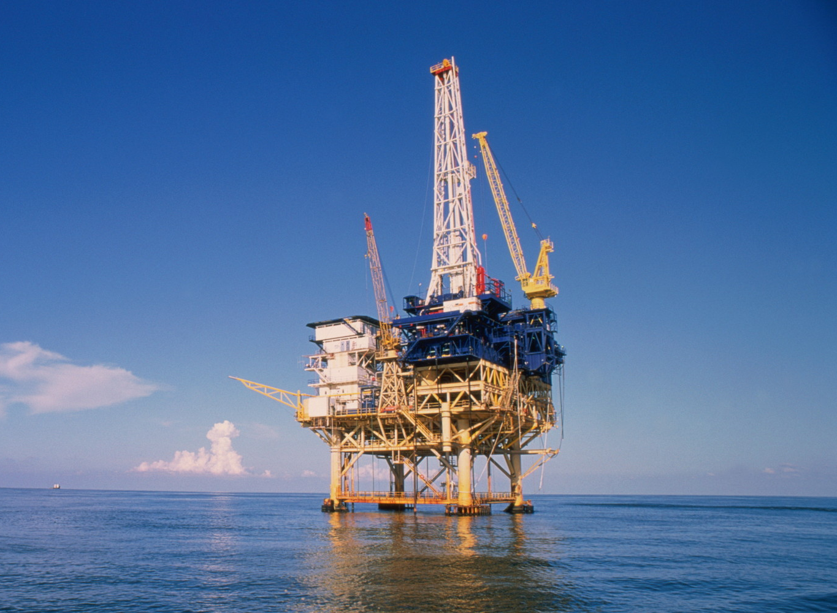
Where does the energy come from?
Nuclear
Wind
Hydro
Solar
Coal
Biomass
Oil

Slide 9
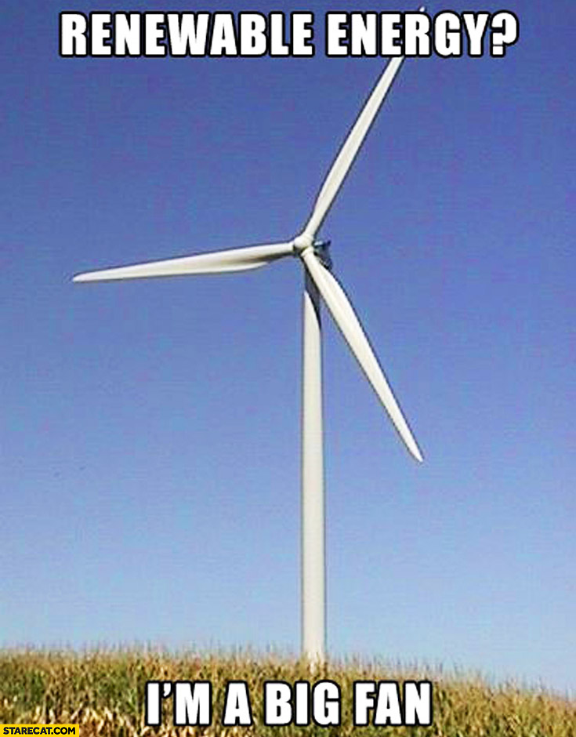

Slide 10
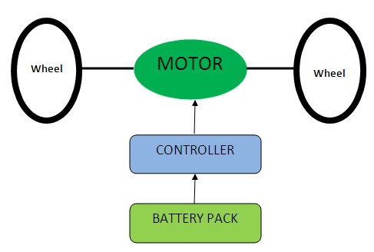
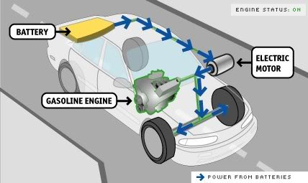
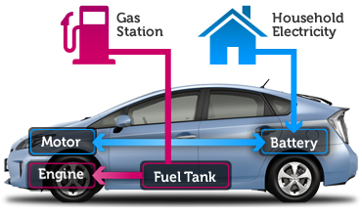
Types of Electric Cars
Full Electric | Hybrid | Plug-In
Runs only on electric engine powered by batteries | Electric engine underscored by an combustion engine | Hybrid car that can be charged externally

Slide 11
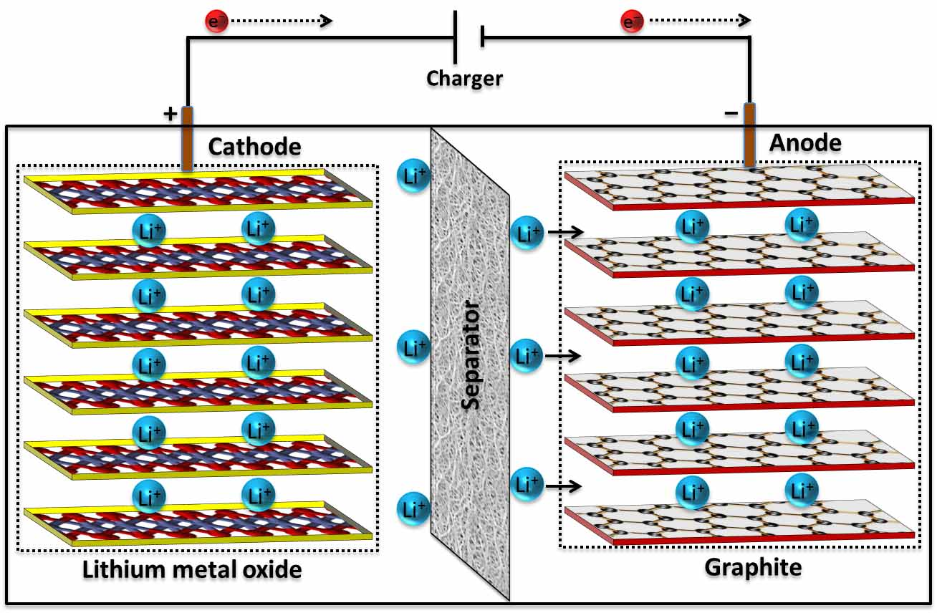
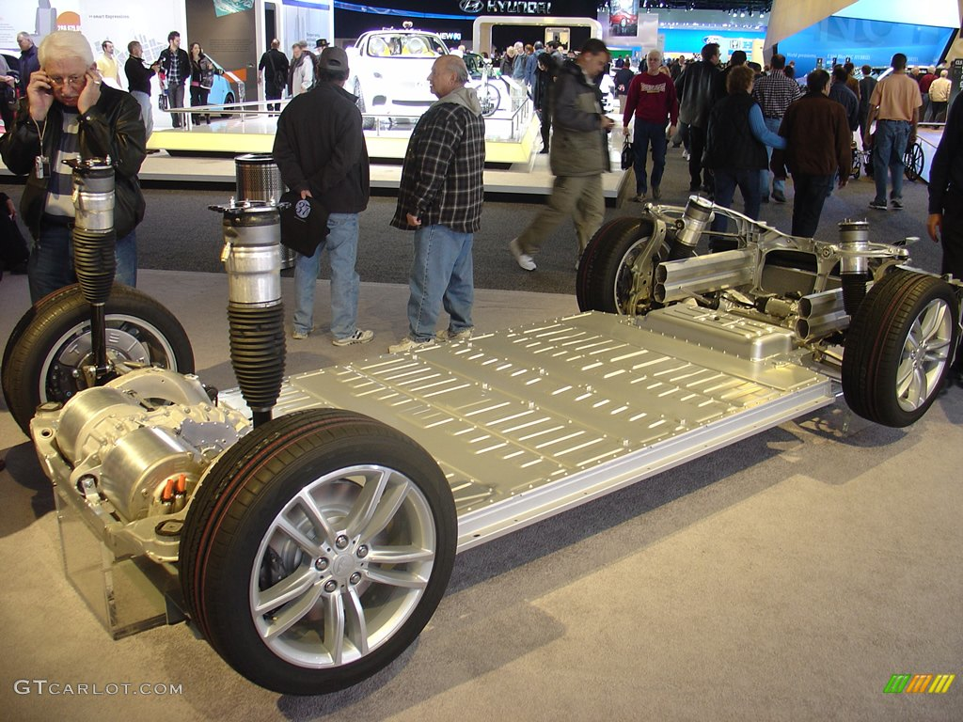
Lithium – ion battery
Stores externally-generated energy
Most promising battery technology
Applied in BEVs, PHEVs and HEVs

Slide 12
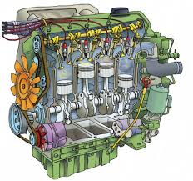
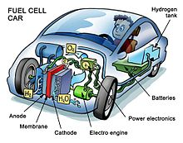
Types of Hydrogen-Powered Cars
Internal Combustion Engine | Fuel-Cell
Burns hydrogen just as gasoline | Converts chemical energy of hydrogen into electrical energy that powers an electric motor

Slide 13
Hydrogen fuel cell
Chemical energy → electric energy
Applied in hydrogen-powered vehicles
External circuit
Current
AIR

Slide 14
Storage and range
Electric Vehicles
Hydrogen-powered vehicles
Storage: * Ni – metal battery
* Li –ion battery
First battery: 50-65 km
→ Tesla Model S: 500 km (4,20 V/cell)
Range: 100-200km
→ limited autonomy
Storage: * Fuel tank
* Pressurized tank
* Metal hydride
Due to H₂ properties
→ difficult to store
Range: + 300km

Slide 15
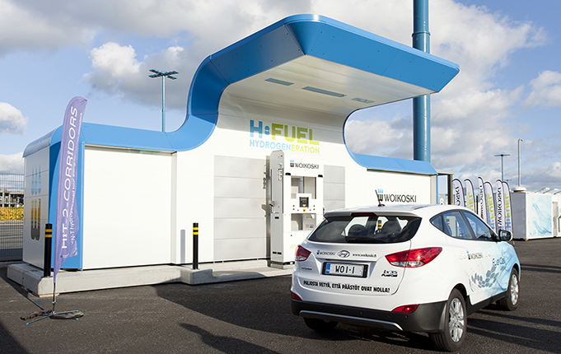
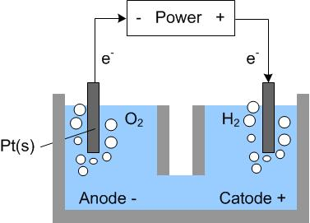
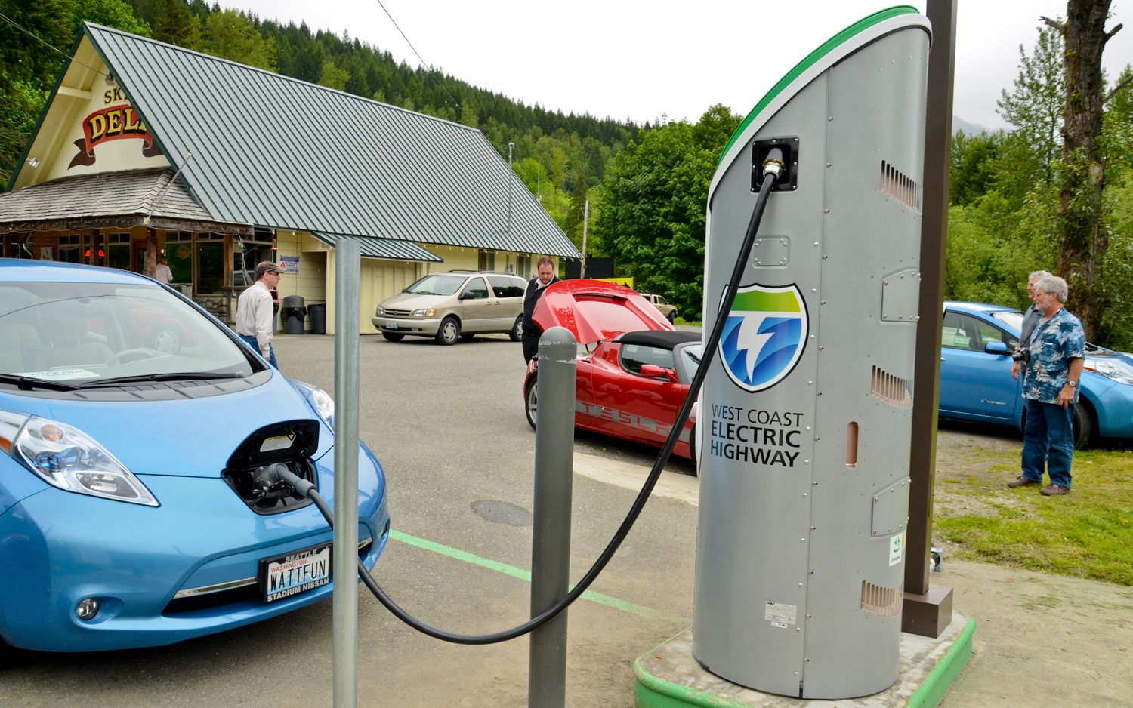
How is energy generated?
Electricity
- Electricity from national grid
Different charging speeds
Duration: 1-10 h
Hydrogen
- Electrolysis
- Steam reforming
No effective ways of generating H₂
Duration: Five min.

Slide 16
Infrastructure
EV – Charging stations in Europe
Hydrogen refueling stations in Europe

Slide 17
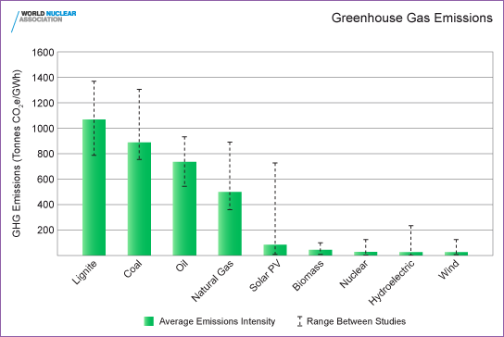
Ecological impact

Slide 18
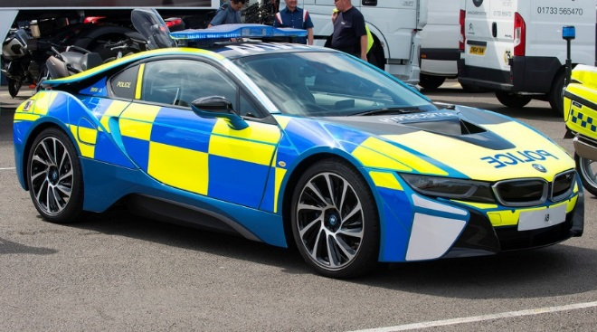
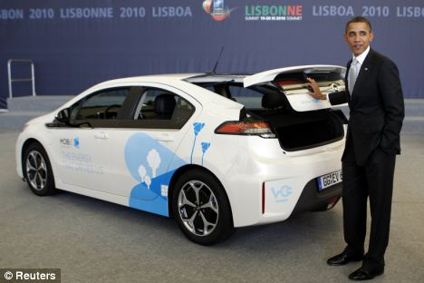
Rasing Social Awareness
Governmental measures:
Subsidies
Tax incentives
Free parking
Free charging
Exclusive areas
Quality seal
Free public transport
No tolls
Government crews driving electrical/hydrogen vehicles

Slide 19
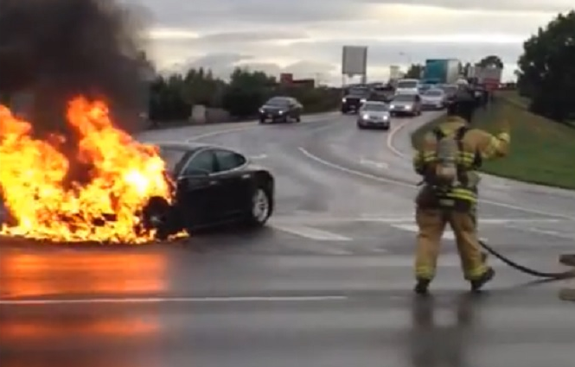
Safety
Electric Cars | Hydrogen-powered Cars
Batteries catching fire Only one accident (autopiloting) reported | High pressure Safe to store

Slide 20
“Sic parvis magna”
From small things comes greatness

Slide 21
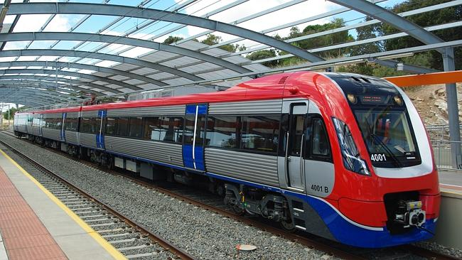
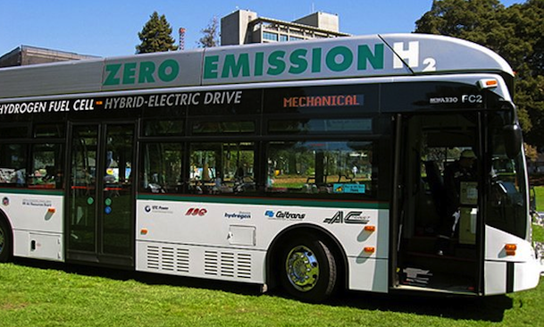
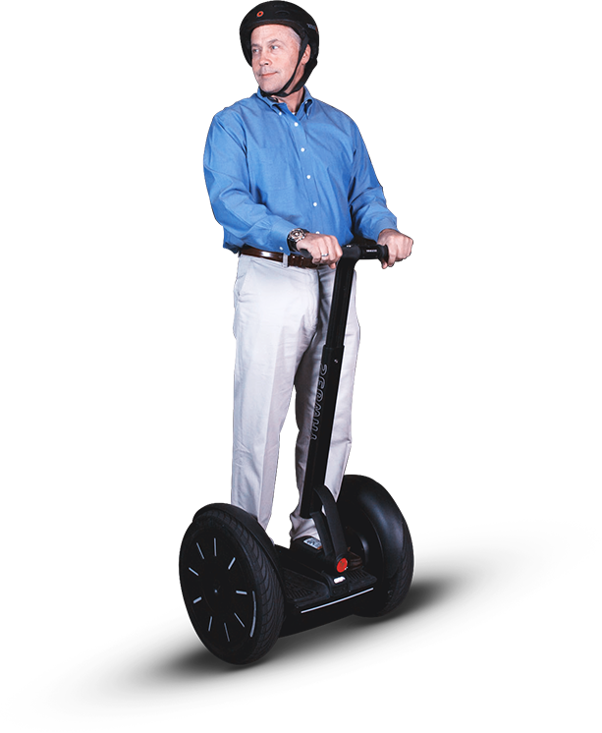
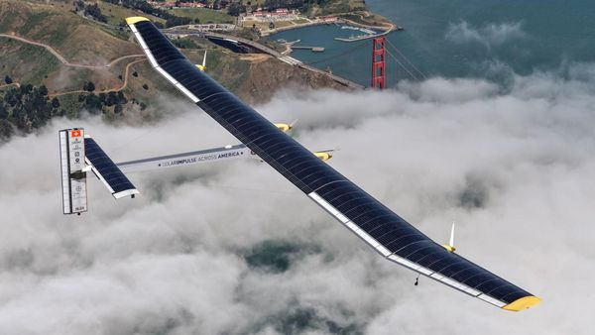
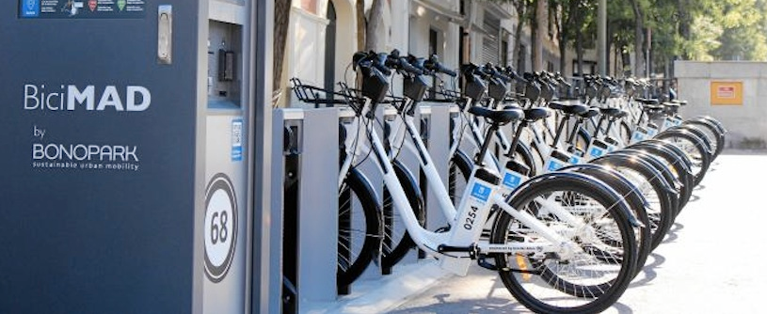
Implementation in other vehicles

Slide 22
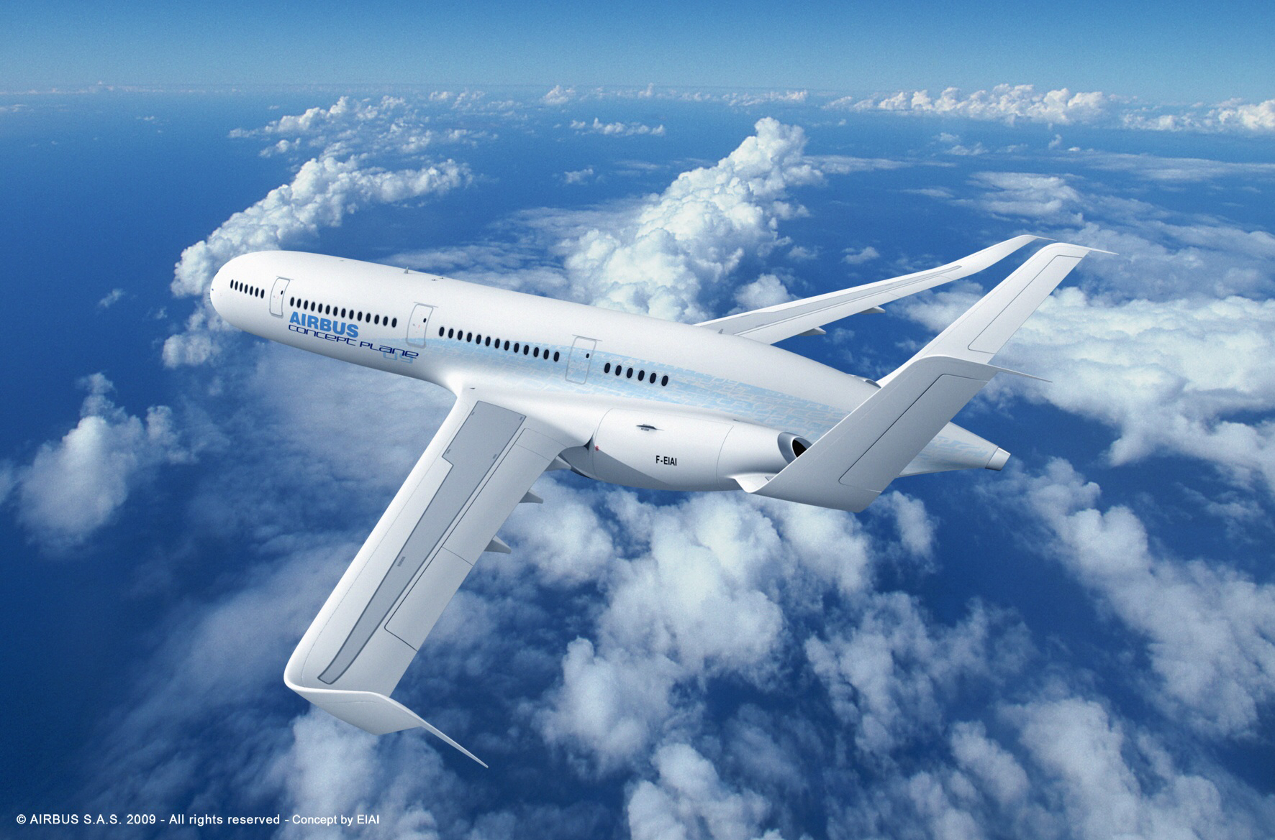
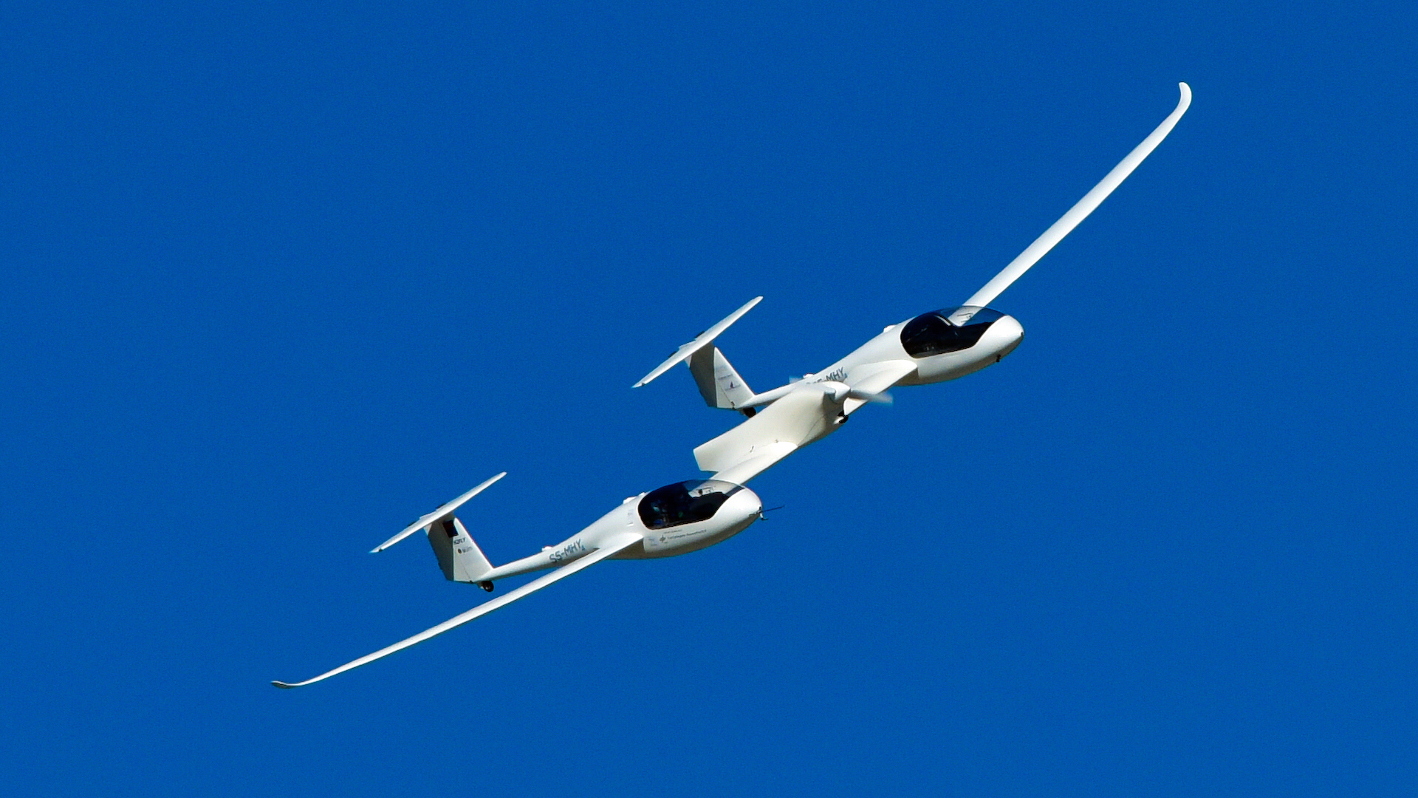
Air transport
Electric
Hydrogen powered
Small airplanes
Passenger airplanes
Fuel cell, take-off helped by battery
Technology not developed enough for commercial aviation
Airbus E-Thrust
HY4: The worlds first passenger aircraft powered by a hydrogen fuel cell

Slide 23
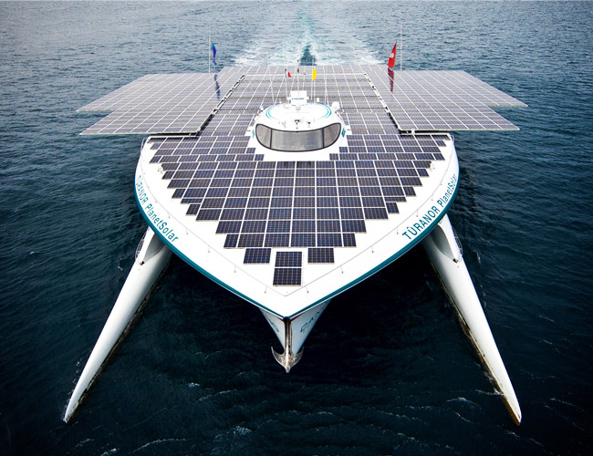
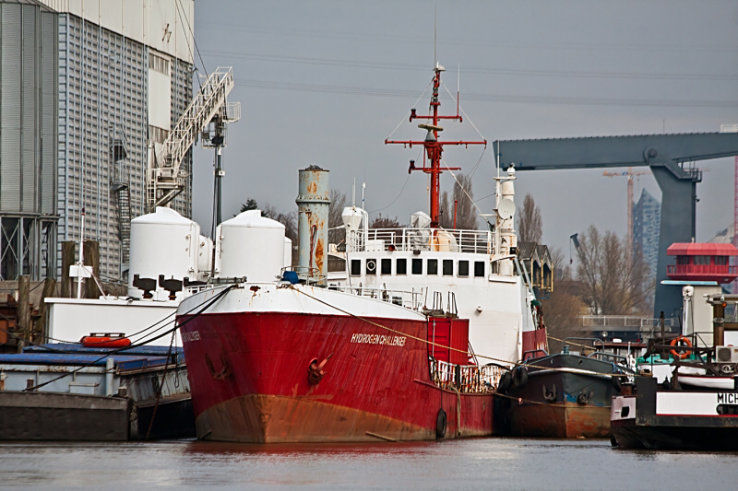
Water transport
The largest container ship pollutes as much as 50 million cars.
Electric ships
Hydrogen powered ships
Turanor PlanetSolar
Hydrogen challenger

Slide 24
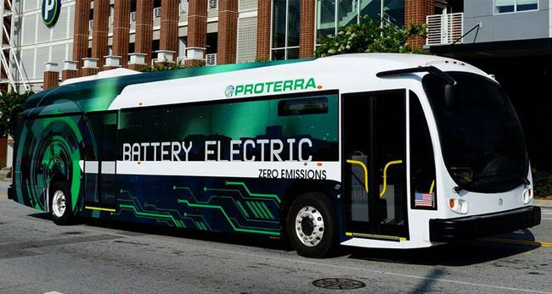
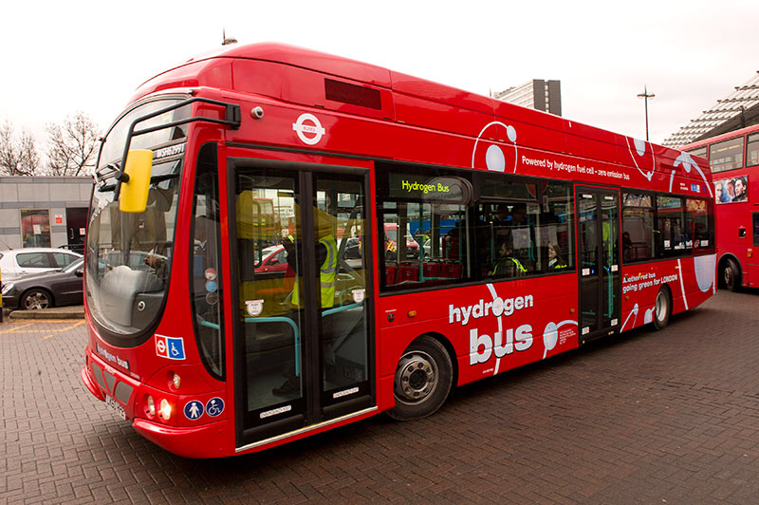
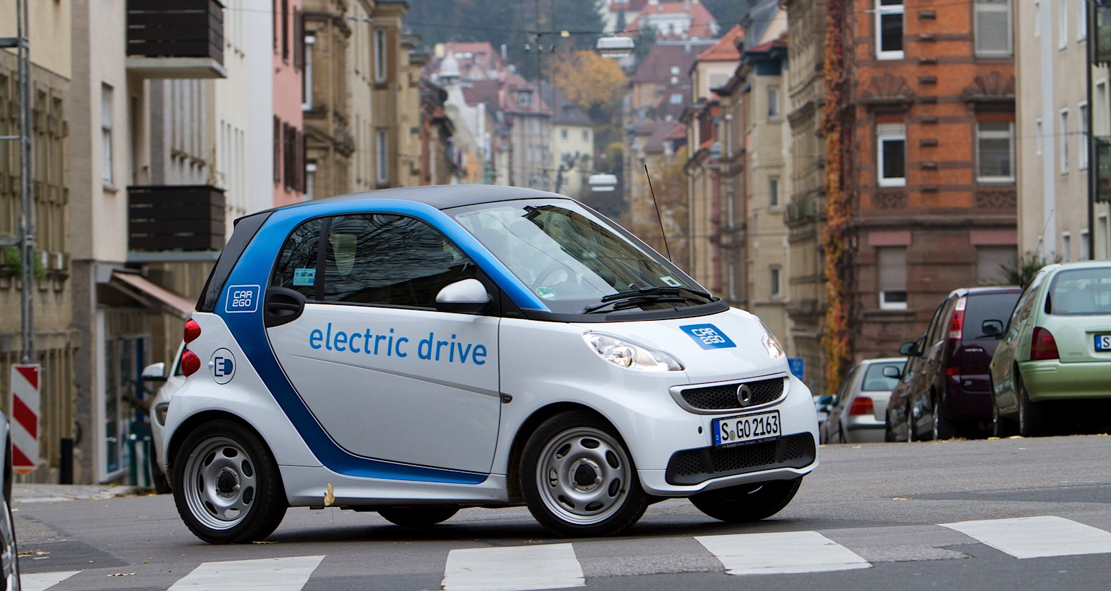
Car sharing
Public transport
Renting a car when you need it
Big cities

Slide 25
Future
Prospective future
Ideal future

Slide 26
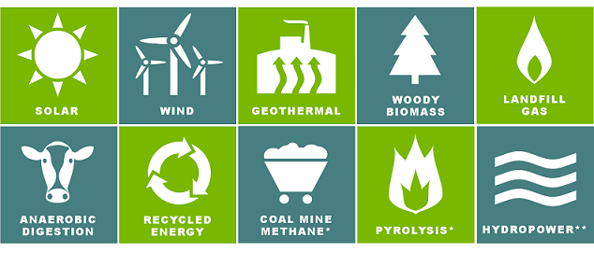
Why should we invest in these technologies?
The importance of using renewable energy
Stop (in)direct pollution
Reduction of CO₂ emissions
Renewable energy will not run out
Not in my backyard
Lack of fossil fuels
Pollution levels
Improvement in health

Slide 27
“You, the people have the power – the power to create machines. The power to create happiness! You, the people, have the power to make this life free and beautiful, to make this life a wonderful adventure.”

Slide 29
