Slide 1
IV INTERNATIONAL YOUTH SCIENTIFIC CONGRESS
HEALTH SCIENCE
Biomedicine and imaging

Slide 2
Research Group
Emanuele Casarini - Italy
Bojana Drča - Serbia
Robin Geesken - The Netherlands
Pil Lincke Jørgensen - Denmark
Charlotte Lens - Belgium
Lorena Meneses Arrizabalaga - Spain
Eva Šantic Zadravec - Slovenia
Viola Schacht - Germany
Dagmara Uszynska - Poland
Sophie Gombar - Hungary
Laura Pérez Marrero - Chairwoman
Marcos Díaz Tarragó - Assistant Chairman

Slide 3
A Little Bit of History

Slide 4
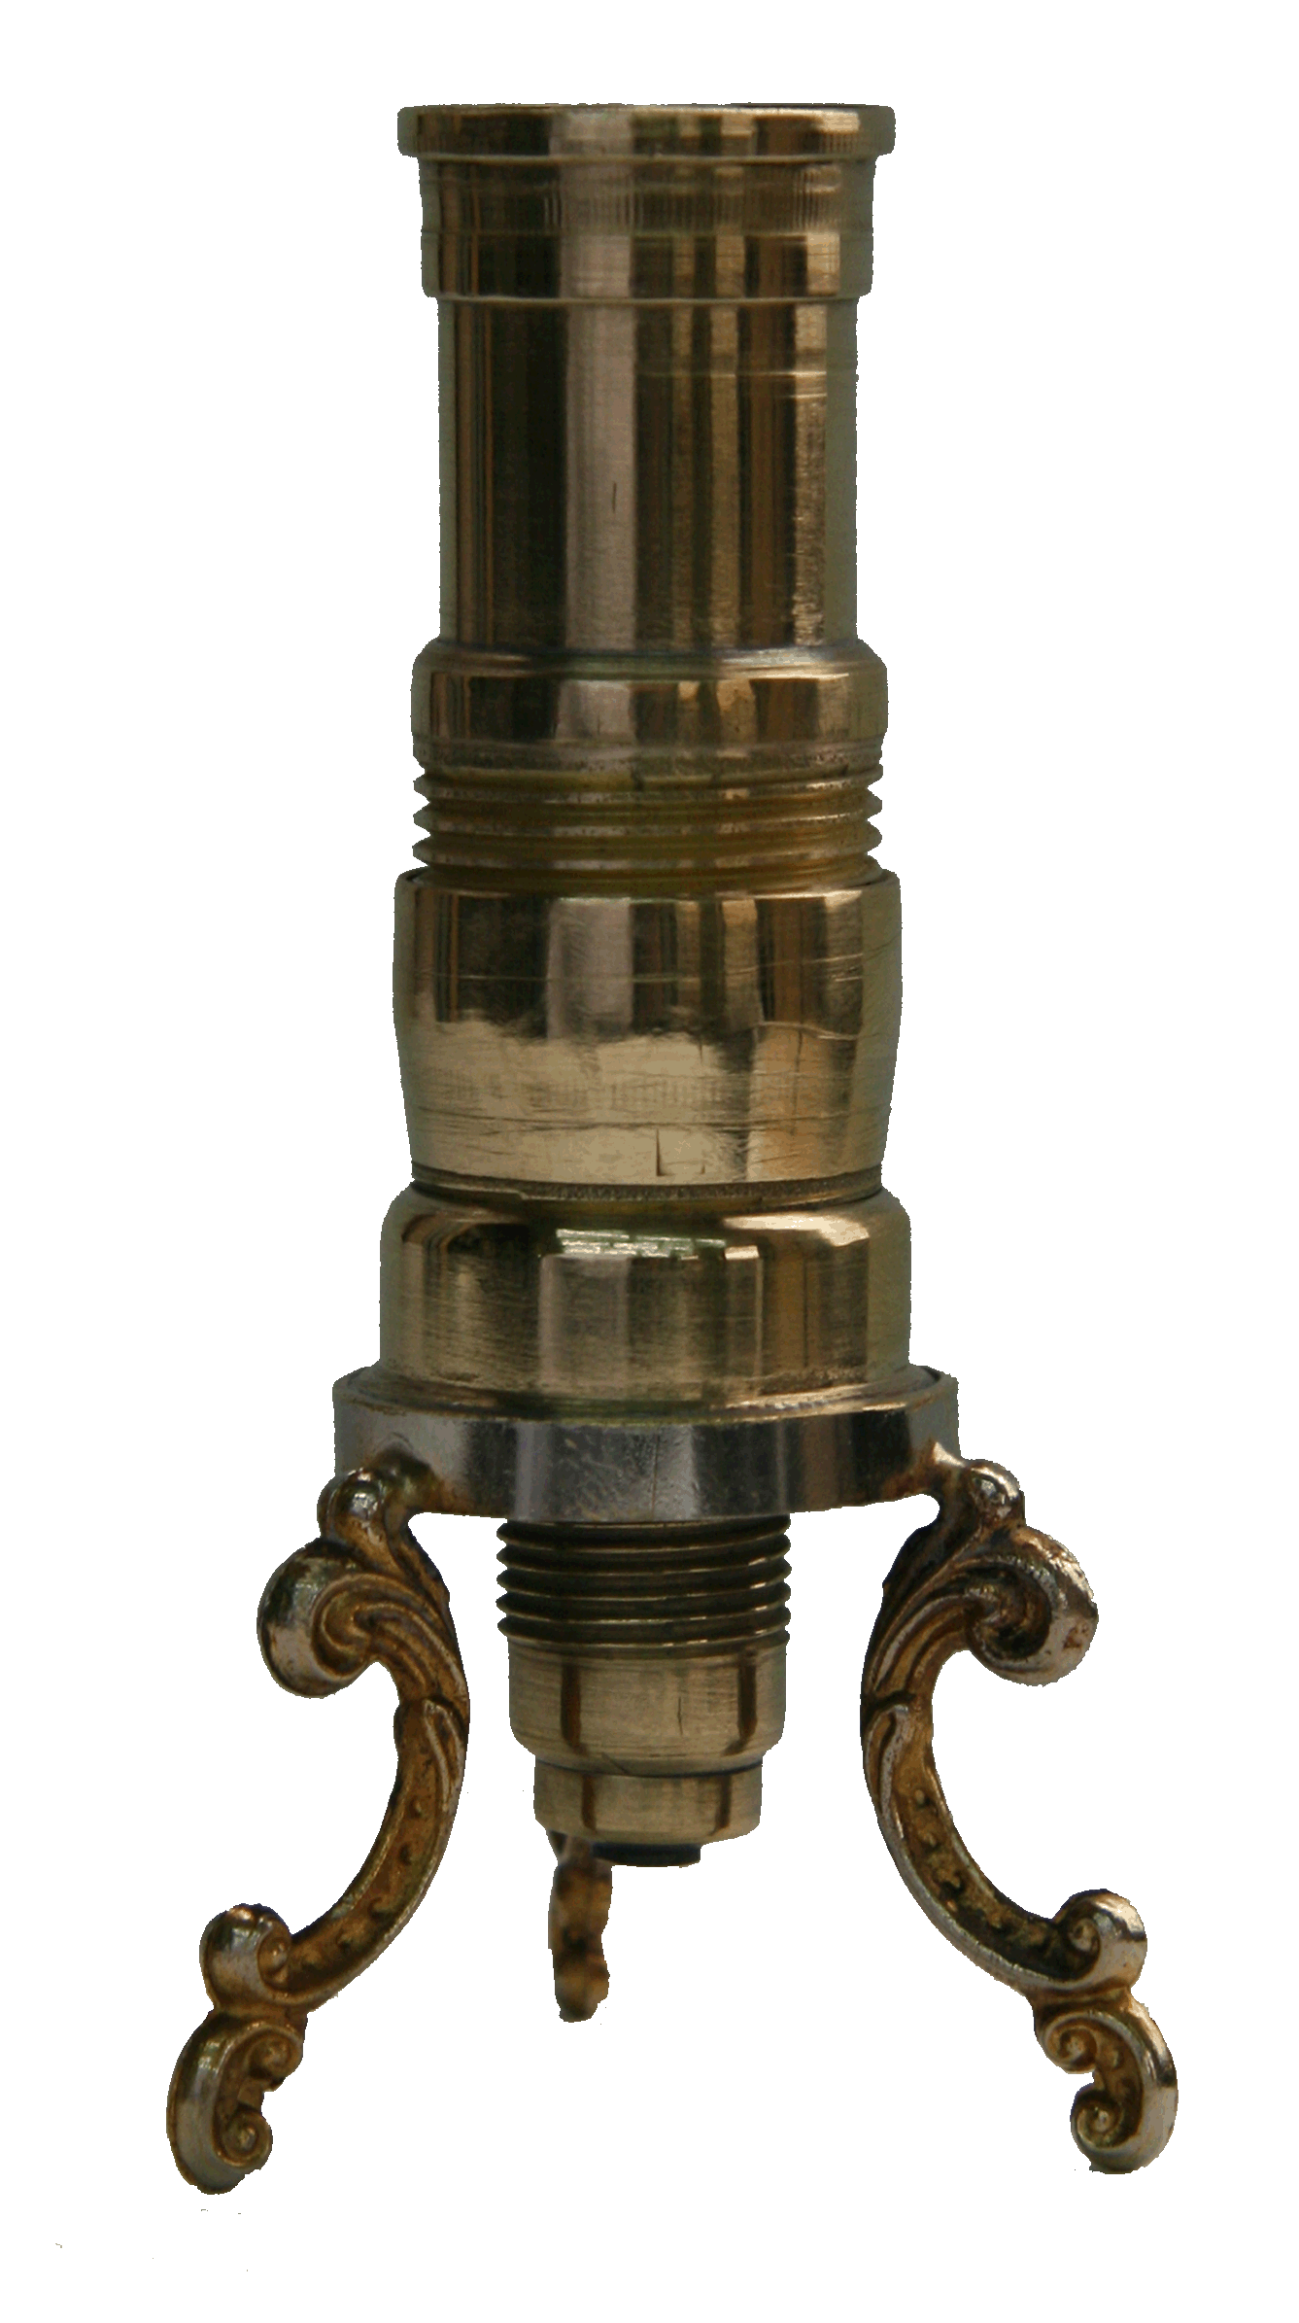
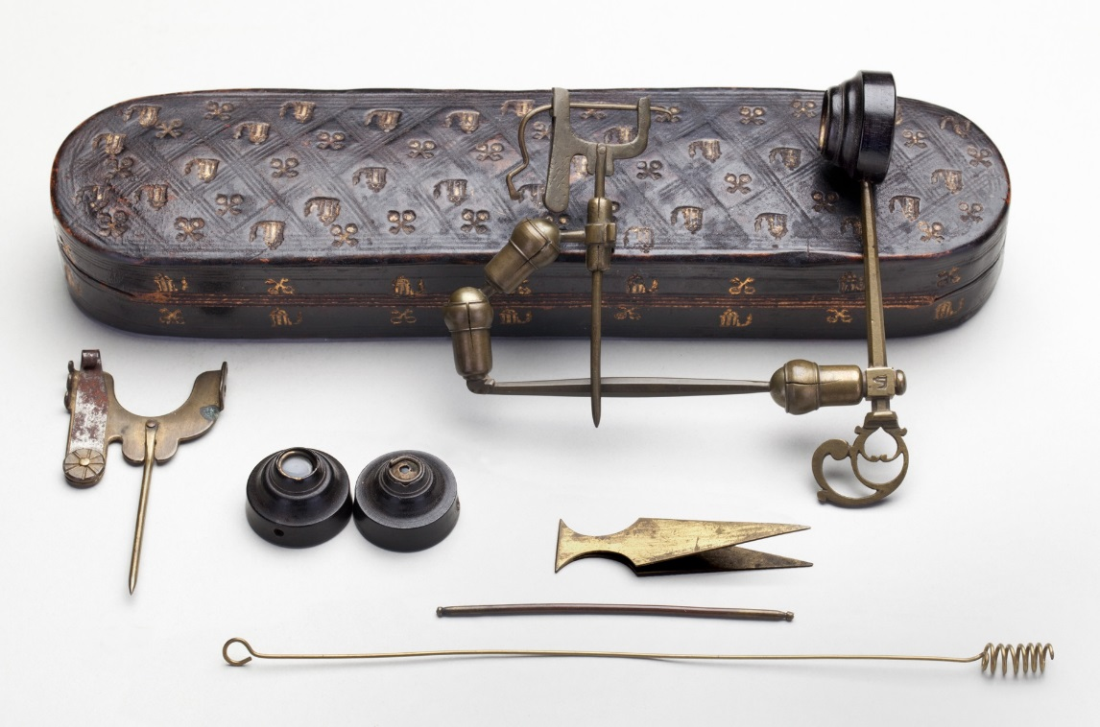
A Little Bit of History
First Simple Microscope “Galileo’s Occhiolino”

Slide 5
A Little Bit of History
First Simple Microscope “Galileo’s Occhiolino”
19th Century – Microscope’s widespreading

Slide 6
A Little Bit of History
First Simple Microscope “Galileo’s Occhiolino”
19th Century – Microscope’s widespreading
Robert Hooke, Leeuwenhoek , Ruska - great minds

Slide 7
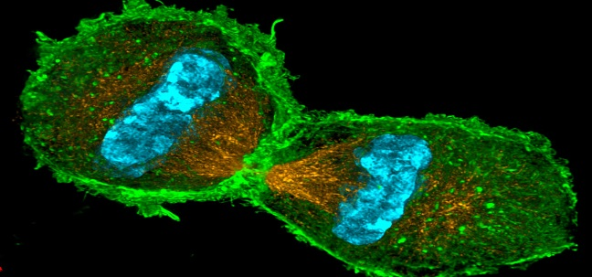
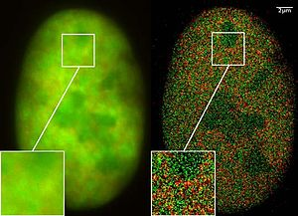
A Little Bit of History
First Electron Microscope 1931
Super Resolution Microscopy 2004
Super-resolution fluorescence microscopy 2014

Slide 8
Magnetism (MRI)
Ultrasound
Xrays
(CT)
Biomedical Imaging
Radioactive Pharmaceuticals
(SPECT; PET)
Light (OCT, endoscopy, carbonfibre)

Slide 10
Let’s Slice the Apple!

Slide 11
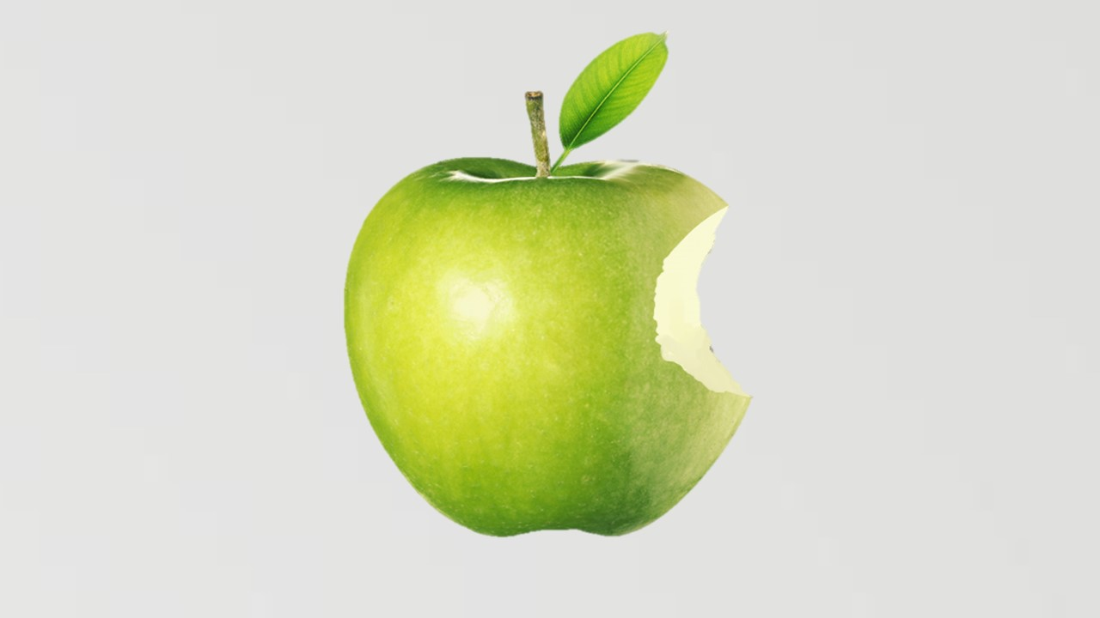

Slide 12
Bright Field Microscope

Slide 13
Difference Between Bright and Dark Microscopy
Stinging cells

Slide 14
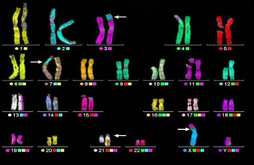
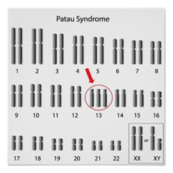
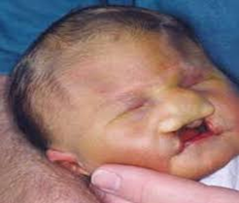
Syndromes
Down syndrome
Patau syndrome

Slide 15
Fluorescence Microscopy

Slide 16
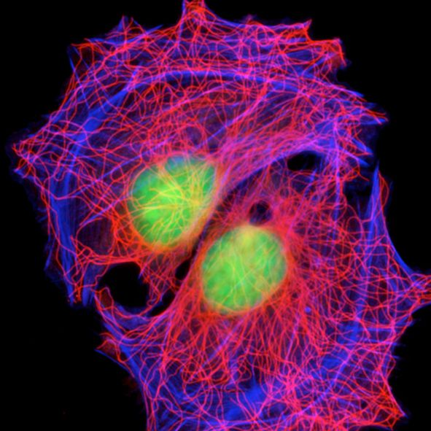
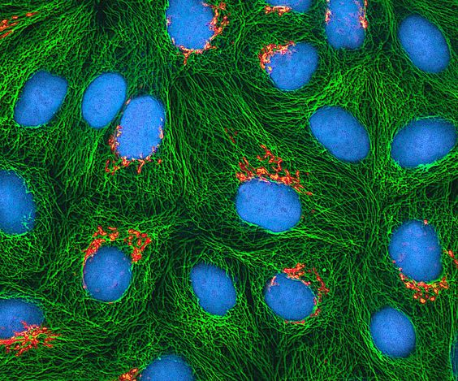
Fluorescence Imaging

Slide 17
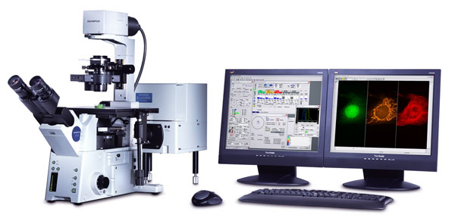
Confocal microscopy
3D reconstruction

Slide 18
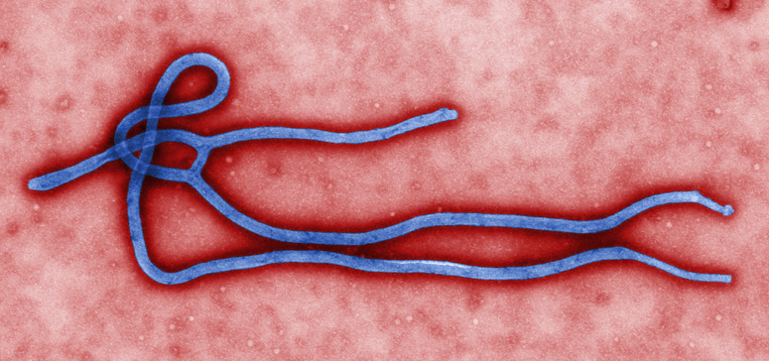
Electron Microscopy
Transmission electron microscope
Scanning electron microscope
Used for detecting emergent diseases such as Ebola

Slide 19
TEM
Transparent specimens
Tridimensional image
Internal composition of the sample

Slide 20
SEM
Three dimensional image
Sample surface
Scattered electrons
Most widely used

Slide 21
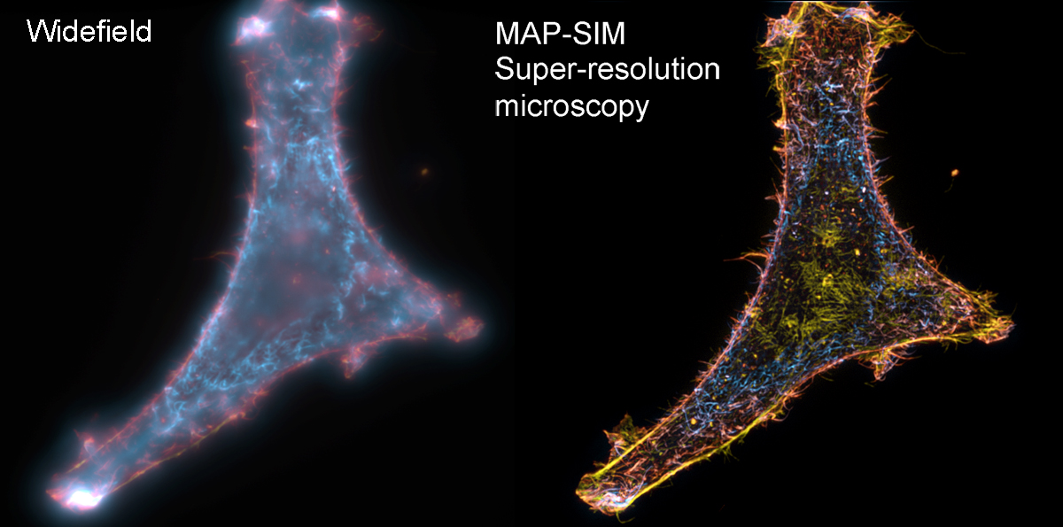
Optical Microscopy
Analysis Automation
Super resolution

Slide 22
Electron Microscopy
Photon detector and contrast
Recorder
Analysis Automation
No need for vacuum and dehydration process

Slide 23
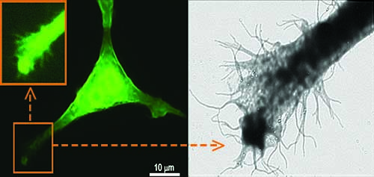
Correlative Microscopy
Combination of fluorescence and electron microscopes

Slide 24
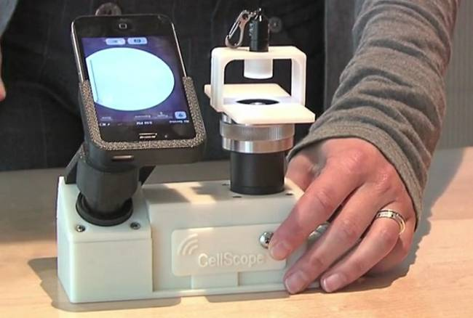
Economics
Expenses
Investments
Awareness
Open new markets
Development of
the phone microscope

Slide 25
3D-Printed Organs

Slide 26
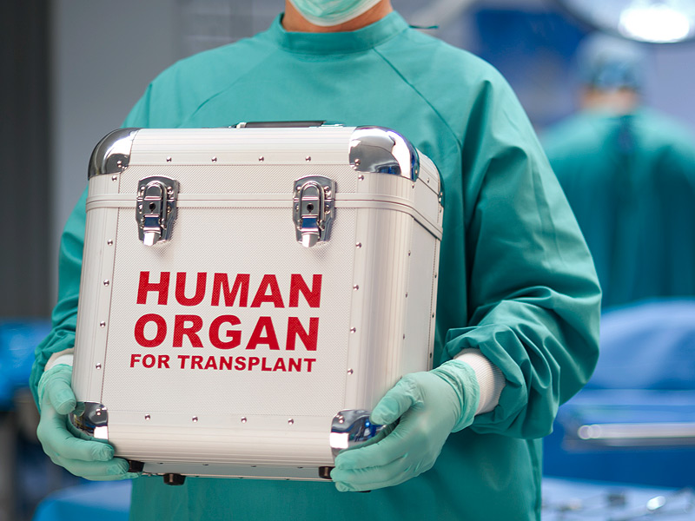
Ethical Issues

